Slide 1
DEMAND ANALYSIS
Ali Can TURAN
Aspiring Supply Chain Data Scientist
08 / 2026
BOTH VIA MS EXCEL AND MACHINE LEARNING
https://github.com/ali-can-turan/
https://github.com/ali-can-turan/case-studies-academic/tree/main/Demand%20Analysis
ali.can.turan@outlook.com
Data is obtained from ‘Demand Analytics Course – Rutgers University / Coursera’

Slide 2
ACTUAL DEMAND VALUES - TABLE
month year | 10-Piece Set sold units | Time in month | 10-Piece Set sale price | Feb | Mar | Apr | May | Jun | Jul | Aug | Oct | Nov | Dec
Jan-11 | 219 | 1 | $949.98 | 0 | 0 | 0 | 0 | 0 | 0 | 0 | 0 | 0 | 0
Feb-11 | 175 | 2 | $949.98 | 1 | 0 | 0 | 0 | 0 | 0 | 0 | 0 | 0 | 0
Mar-11 | 306 | 3 | $949.98 | 0 | 1 | 0 | 0 | 0 | 0 | 0 | 0 | 0 | 0
Apr-11 | 394 | 4 | $949.98 | 0 | 0 | 1 | 0 | 0 | 0 | 0 | 0 | 0 | 0
May-11 | 394 | 5 | $949.98 | 0 | 0 | 0 | 1 | 0 | 0 | 0 | 0 | 0 | 0
Jun-11 | 131 | 6 | $949.98 | 0 | 0 | 0 | 0 | 1 | 0 | 0 | 0 | 0 | 0
Jul-11 | 131 | 7 | $949.98 | 0 | 0 | 0 | 0 | 0 | 1 | 0 | 0 | 0 | 0
Aug-11 | 438 | 8 | $949.98 | 0 | 0 | 0 | 0 | 0 | 0 | 1 | 0 | 0 | 0
Sep-11 | 525 | 9 | $949.98 | 0 | 0 | 0 | 0 | 0 | 0 | 0 | 0 | 0 | 0
Oct-11 | 613 | 10 | $949.98 | 0 | 0 | 0 | 0 | 0 | 0 | 0 | 1 | 0 | 0
Nov-11 | 657 | 11 | $949.98 | 0 | 0 | 0 | 0 | 0 | 0 | 0 | 0 | 1 | 0
Dec-11 | 394 | 12 | $949.98 | 0 | 0 | 0 | 0 | 0 | 0 | 0 | 0 | 0 | 1
Jan-12 | 354 | 13 | $949.98 | 0 | 0 | 0 | 0 | 0 | 0 | 0 | 0 | 0 | 0
Feb-12 | 706 | 14 | $949.98 | 1 | 0 | 0 | 0 | 0 | 0 | 0 | 0 | 0 | 0
Mar-12 | 603 | 15 | $949.98 | 0 | 1 | 0 | 0 | 0 | 0 | 0 | 0 | 0 | 0
Apr-12 | 603 | 16 | $949.98 | 0 | 0 | 1 | 0 | 0 | 0 | 0 | 0 | 0 | 0
May-12 | 367 | 17 | $949.98 | 0 | 0 | 0 | 1 | 0 | 0 | 0 | 0 | 0 | 0
Jun-12 | 328 | 18 | $949.98 | 0 | 0 | 0 | 0 | 1 | 0 | 0 | 0 | 0 | 0
Jul-12 | 509 | 19 | $949.98 | 0 | 0 | 0 | 0 | 0 | 1 | 0 | 0 | 0 | 0
Aug-12 | 429 | 20 | $949.98 | 0 | 0 | 0 | 0 | 0 | 0 | 1 | 0 | 0 | 0
Sep-12 | 417 | 21 | $949.98 | 0 | 0 | 0 | 0 | 0 | 0 | 0 | 0 | 0 | 0
Oct-12 | 1,553 | 22 | $799.95 | 0 | 0 | 0 | 0 | 0 | 0 | 0 | 1 | 0 | 0
Nov-12 | 1,670 | 23 | $799.95 | 0 | 0 | 0 | 0 | 0 | 0 | 0 | 0 | 1 | 0
Dec-12 | 1,204 | 24 | $799.95 | 0 | 0 | 0 | 0 | 0 | 0 | 0 | 0 | 0 | 1
Continuous variables
Time in month
10-Piece Set sale price
Categoric variables
Months → N-1 rule applied: 2 months with baseline demand removed.
Target variable
10-Piece Set sols units

Slide 3
VIA EXCEL ANALYSIS TOOLPAK REGRESSION

Slide 4
VIA EXCEL ANALYSIS TOOLPAK REGRESSION
SUMMARY OUTPUT
Regression Statistics
Multiple R | 0.974241697
R Square | 0.949146885
Adjusted R Square | 0.893670759
Standard Error | 129.6407713
Observations | 24
Categoric variable ‘Nov’ is the only one with a significant p value.
Train R square is 94.92%.
Test R square is 42.93%.
Normal with scarce test data → test_size=3
 | Coefficients | P-value
Intercept | 4855.135495 | 7.66E-05
Time in month | 15.58146067 | 0.008349
10-Piece Set sale price | -4.892504645 | 8.03E-05
Feb | 108.494382 | 0.358496
Mar | 106.9129213 | 0.363141
Apr | 135.3314607 | 0.253762
May | 1.75 | 0.987843
Jun | -164.8314607 | 0.170437
Jul | -89.91292135 | 0.441833
Aug | 8.005617978 | 0.944896
Oct | 259.3314607 | 0.060879
Nov | 324.25 | 0.024156
Dec | -55.83146067 | 0.661821

Slide 5

VIA EXCEL ANALYSIS TOOLPAK REGRESSION

Slide 6

VIA EXCEL ANALYSIS TOOLPAK REGRESSION
Residual Validation
Normality: YES
Skewness: 0.25
Kurtosis: - 0.29
Linearity: seems NOT PERFECT → more positive values than negative ones
Independence: YES
Durbin Watson p_value: 0.06
Between (- 0.25, 0.25)
Equal Variance: seems OK.
Train Residual Mean: ~0
Test Residual Mean: -53

Slide 7
VIA EXCEL ANALYSIS TOOLPAK REGRESSION
TEST DATA
month year | 10-Piece Set sold units | Time in month | 10-Piece Set sale price | Feb | Mar | Apr | May | Jun | Jul | Aug | Oct | Nov | Dec
Jan-13 | 1069 | 25 | $799.95 | 0 | 0 | 0 | 0 | 0 | 0 | 0 | 0 | 0 | 0
Feb-13 | 1536 | 26 | $799.95 | 1 | 0 | 0 | 0 | 0 | 0 | 0 | 0 | 0 | 0
Mar-13 | 1490 | 27 | $799.95 | 0 | 1 | 0 | 0 | 0 | 0 | 0 | 0 | 0 | 0
TEST DATA PREDICTIONS
1331
1455
1469
METRICS
Mean Absolute Error | Weighted Mean Absolute Percentage Error
121.31 | 8.89%

Slide 8
VIA PYTHON, SCIKIT-LEARN AND STATSMODELS LIBRARIES

Slide 9
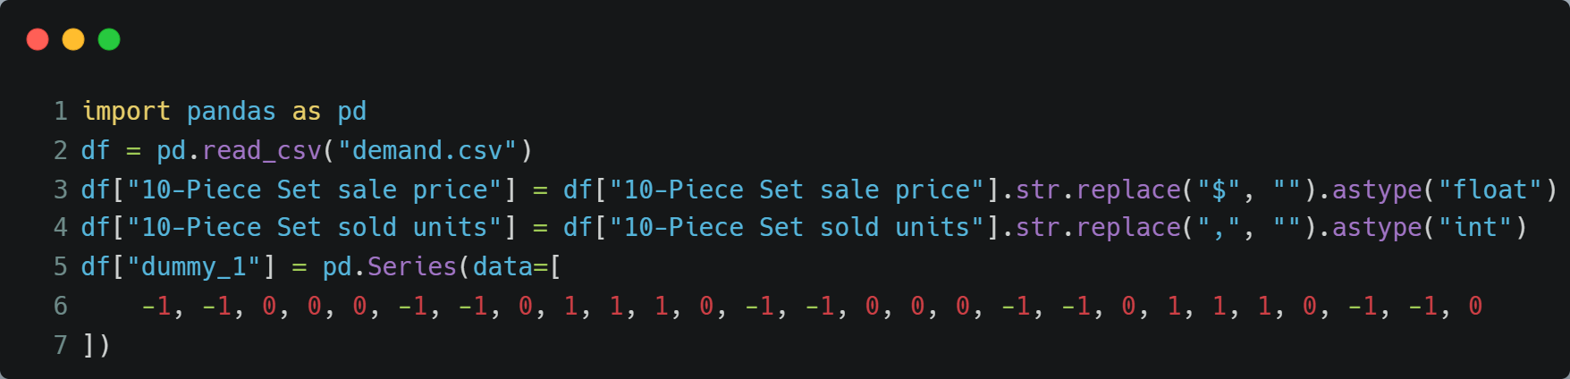
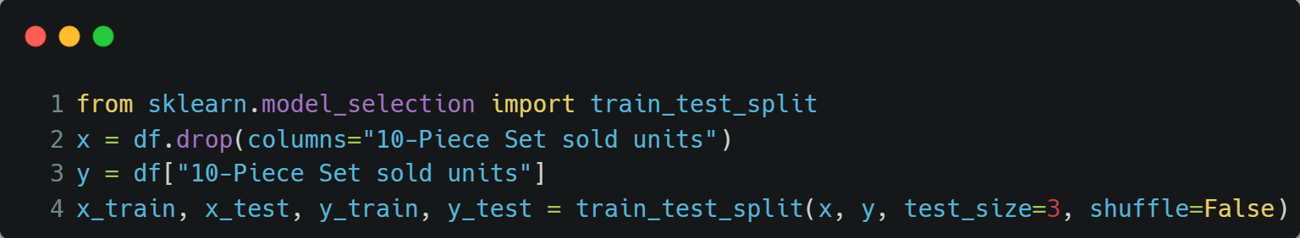
VIA PYTHON SCIKIT-LEARN LIBRARY
Data Preparation
Remarks
«dummy_1» variable added.
This variable quantify peak, normal, valley seasons in 3 categories. For simplicity and accuracy, quantifications are determined from the first 12 months only.
Shuffle=False as this is a time series data, we strictly want the very last rows to be in the test portion.
Train Test Split

Slide 10
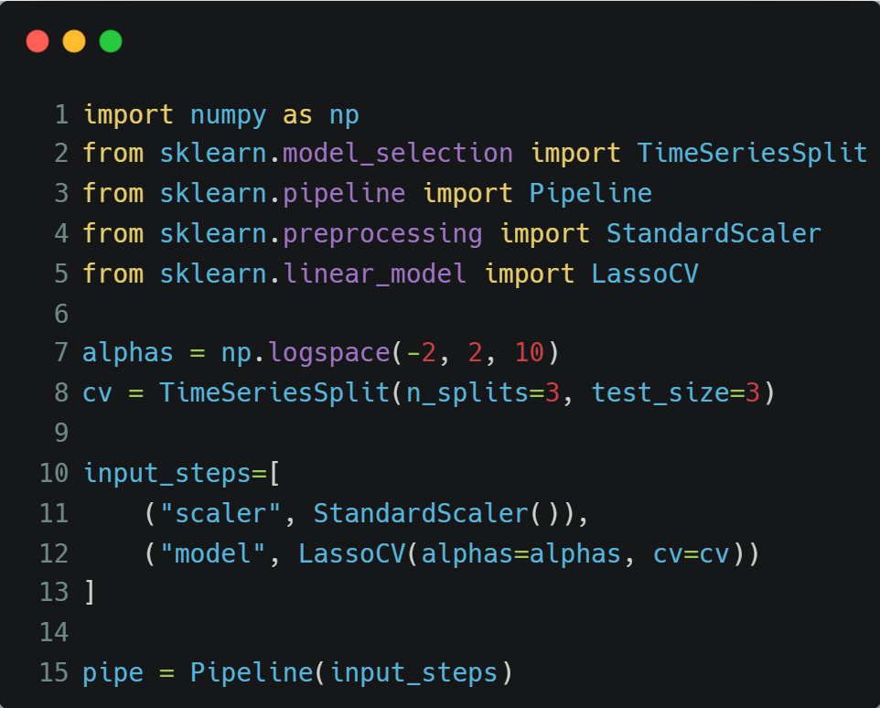
VIA PYTHON SCIKIT-LEARN LIBRARY
Pipeline
Remarks
Imputer: not used as growth in sales envisaged.
Pollynomial featuring: not used due to data scarcity and high dimensionality.
LinearRegression: not favored as it causes overfitting on scarce data
StandardScaler: used as value ranges differ between variables and LassoCV / RidgeCV uses regularization that stipulates scaling.
RidgeCV: not favored as ‘zero’ coefficients envisaged for some categorical variables.
TimeSeriesSplit: favored against LeaveOneOut as the latter generates convergence problems with LassoCV and data at hand is a real time series data.
SelectKBest: not used as all categorical variables desired to be included at the beginning and conformity with excel solution.

Slide 11
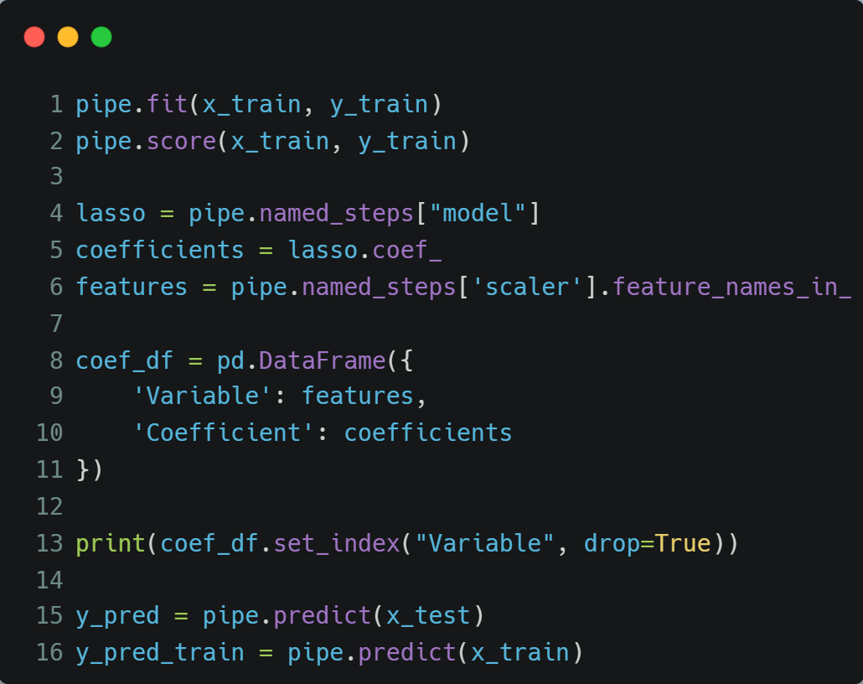
VIA PYTHON SCIKIT-LEARN LIBRARY
Fit – Predict
Remarks
Train R square is 95.02%.
Best alpha: 0.01, meaning the regularization is small.
Nov, Oct → visible from coefficients that the demand is high.
Price → price is more influential than Nov, Oct.
Variable | Coefficient
Time in month | 102.731527
10-Piece Set sale price | -245.681800
Feb | 38.436457
Mar | 29.114520
Apr | 37.173605
May | 0.458259
Jun | -36.269958
Jul | -15.358889
Aug | 2.801206
Oct | 62.360829
Nov | 80.507910
Dec | -15.228663
dummy_1 | 24.969061

Slide 12
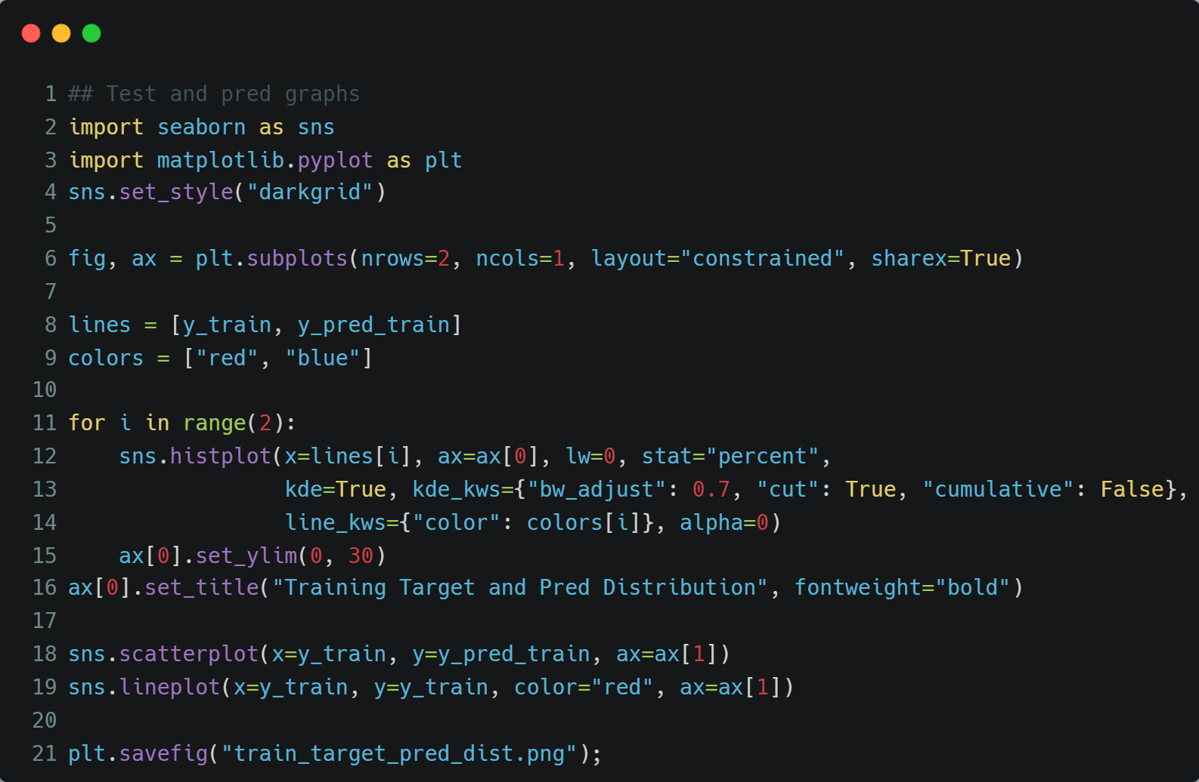
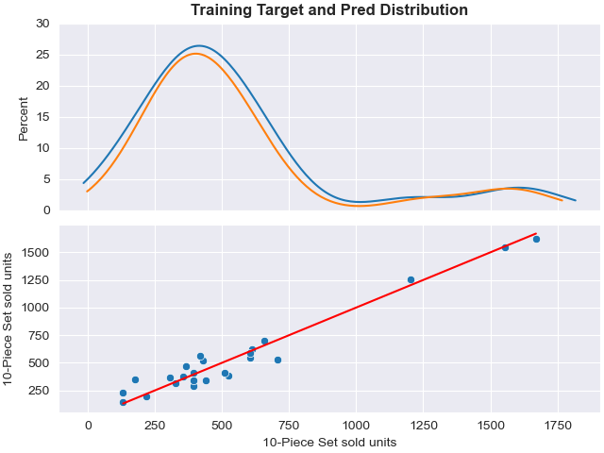
VIA PYTHON SCIKIT-LEARN LIBRARY
Target and Pred Distribution: training data

Slide 13
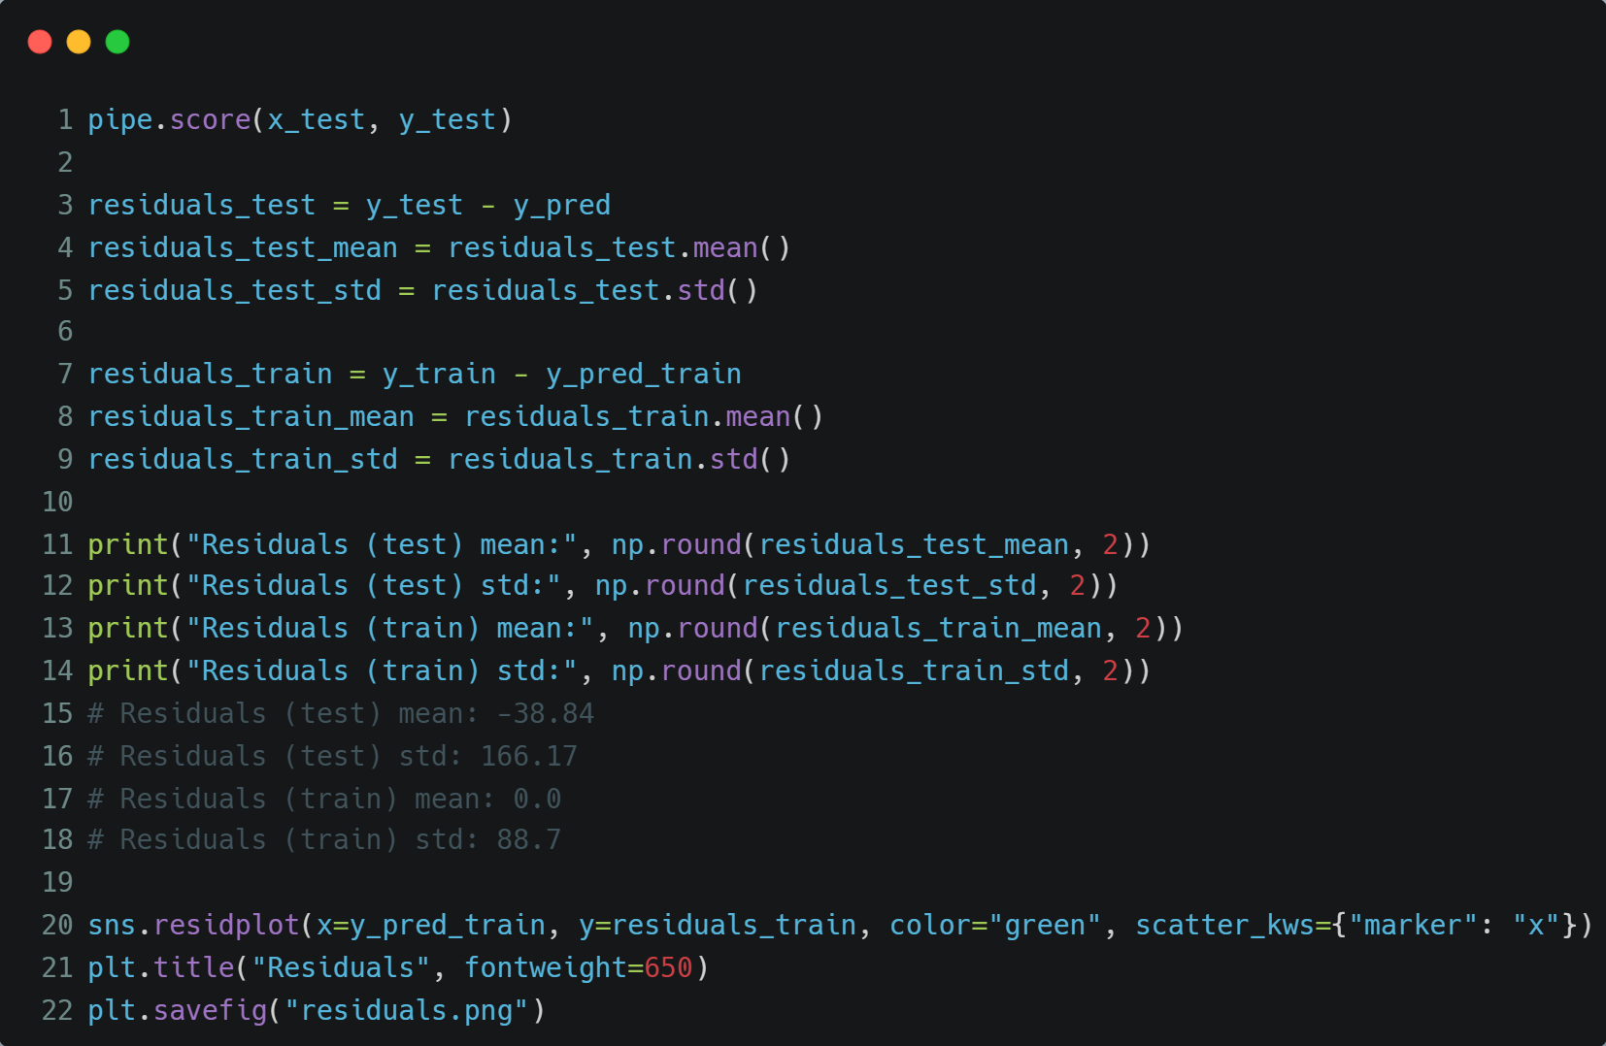
VIA PYTHON SCIKIT-LEARN LIBRARY
Residuals
Remarks
Residuals (test) mean: problematic, distant from 0. But that’s normal with scarce training and scarce test data.
Residuals (train) mean: OK!
Test R square is 54.90%.
Normal with scarce test data.

Slide 14
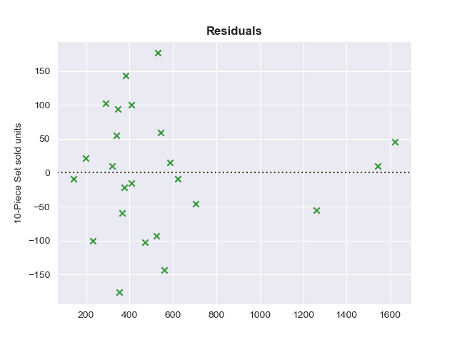
VIA PYTHON SCIKIT-LEARN LIBRARY
Residuals – validation -1
Remarks
Validation from the plot ONLY:
Normality: data points close to 0 are more congested than the others → seems OK!
Linearity: positive and negative data points count are the same. Moreover, no evident pattern in the residuals → seems OK!
Independence: no orto-correlation within residuals → seems OK.
Equal variance: problematic! slight increase in variance for the data points in the middle. But this pattern does not continue towards the far end of the x range: problem is small

Slide 15
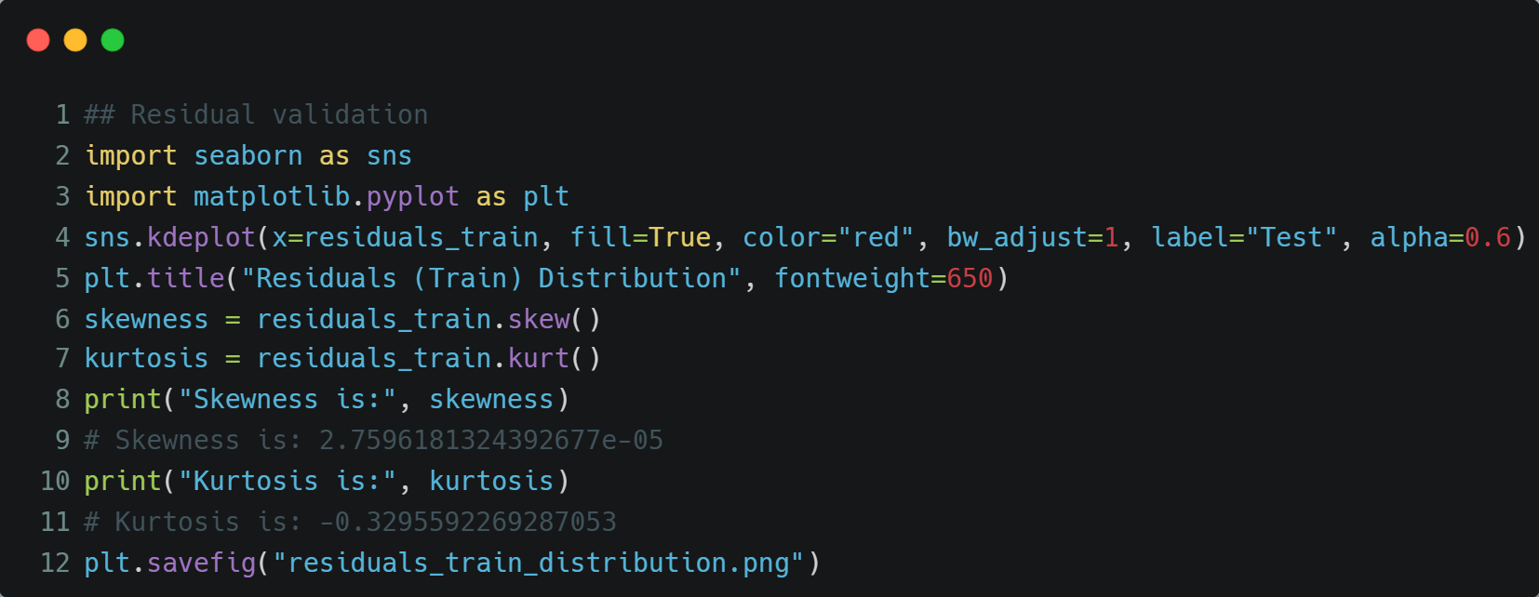
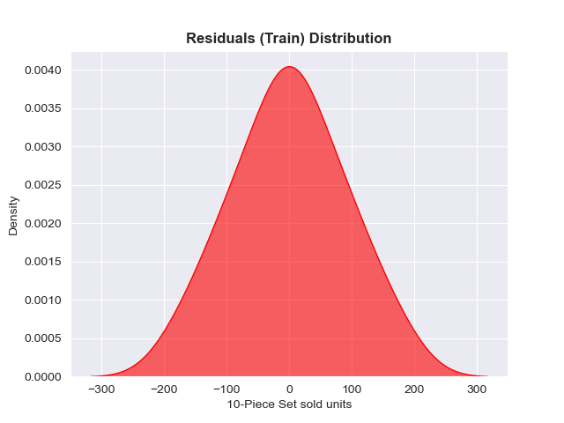
VIA PYTHON SCIKIT-LEARN LIBRARY
Residuals – Validation - 2
Remarks
Normality:
Skewness: 2.75e-5
Kurtosis: -0.33
Highly small values. OK!

Slide 16
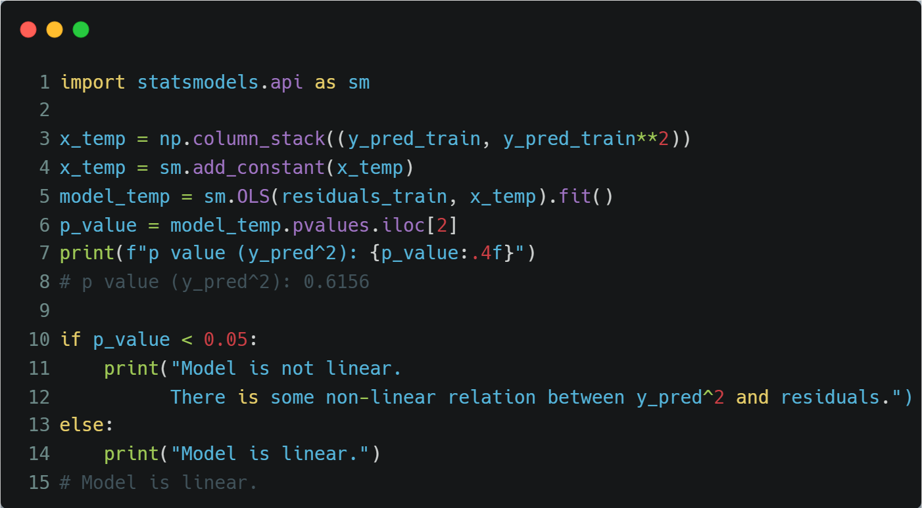
VIA PYTHON SCIKIT-LEARN LIBRARY
Residuals – Validation - 3
Remarks
Linearity:
OK!
Y_pred^2 p value: 0.6156
Square of target prediction values (training) does not pose a significant relation towards residuals

Slide 17
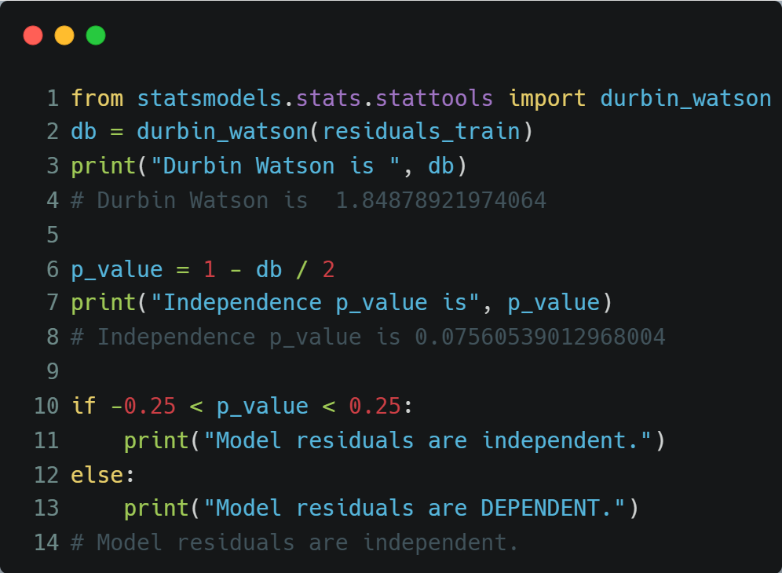
VIA PYTHON SCIKIT-LEARN LIBRARY
Residuals – Validation - 4
Remarks
Independence:
OK!
Durbin Watson p value: 0.0756
NO orto-correlation.

Slide 18
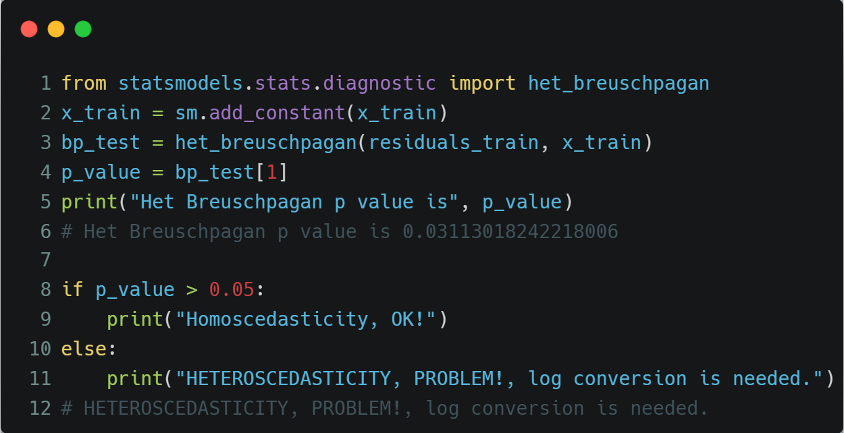
VIA PYTHON SCIKIT-LEARN LIBRARY
Residuals – Validation - 5
Remarks
Equal variance:
NOT SUPERB!
BP p value: 0.0311
HETEROSCEDASTICITY.
P value is not that small. No action needed.

Slide 19
VIA PYTHON SCIKIT-LEARN LIBRARY
TEST DATA
month year | 10-Piece Set sold units | Time in month | 10-Piece Set sale price | Feb | Mar | Apr | May | Jun | Jul | Aug | Oct | Nov | Dec
Jan-13 | 1069 | 25 | $799.95 | 0 | 0 | 0 | 0 | 0 | 0 | 0 | 0 | 0 | 0
Feb-13 | 1536 | 26 | $799.95 | 1 | 0 | 0 | 0 | 0 | 0 | 0 | 0 | 0 | 0
Mar-13 | 1490 | 27 | $799.95 | 0 | 1 | 0 | 0 | 0 | 0 | 0 | 0 | 0 | 0
TEST DATA PREDICTIONS
1297
1451
1465
METRICS
Mean Absolute Error | Weighted Mean Absolute Percentage Error
112.87 | 8.26%

Slide 20
COMPARISON SUMMARY
Metric | Metric-2 | MS Excel | Python Scikit Learn | Winner
Train R Square |  | 94.92% | 95.02% | Python
Test R Square |  | 42.93% | 54.90% | Python
MAE |  | 121.31 | 112.87 | Python
WMAPE |  | 8.89% | 8.26% | Python
Train Residuals mean |  | ~0 | ~0 | -
Train Residuals Validation | Normality - Skewness | 0.25 | 2.75E-5 | Python
 | Normality - Kurtosis | - 0.29 | - 0.32 | Excel
 | Linearity | Seems NOT OK! | 0.6156 | Python
 | Independence - DB | 0.06 | 0.0756 | Python
 | Equal Variance | Seems OK! | 0.0311 | -
Test Residuals Mean |  | - 53 | - 38 | Python
Test R square metrics are to grow with more data. Test size was ONLY 3.
With the additional dummy categoric variable in Python, Python gained a slight edge over excel results

